Slide 1
SMART TEMPERATURE DETECTION SYSTEM
GROUP MEMBERS:
1. SAURABH RAUT
2. DARPAN SETHI
3. SUBHASH DEMUNDE
4. ROHITH PULLURI
PROJECT GUIDE:
PROF. ANAND BHOSALE

Slide 2
ABSTRACT
The system proposed in this report is an advanced solution for monitoring temperature at particular place which will raise an alert as soon as temperature goes beyond certain range. The technology behind this is cloud computing, Internet of Things which is an advanced and efficient solution for connecting the entire world of things in a network. The systems deals with monitoring and controlling environmental condition like temperature with sensors and send this information to cloud. The data updated from the current reading can be used to generate an e-alert if the temperature goes beyond certain limit.

Slide 3
LITERATURE SURVEY:
We have referred following IEEE papers for our project:
Cloud of Things: Integrating Internet of Things and cloud computing and the issues involved.
(Alessio Botta, Walter de Donato, Valerio Persico, Antonio Pescap´e
University of Napoli Federico II)
Cloud of Things: Integrating Internet of Things and Cloud Computing and the Issues Involved.
Internet of Things-based Temperature Tracking System.

Slide 4
CURRENT VS OUR SYSTEM
Current system uses temperature sensor that will detect the sudden increase in temperature, and if it crosses certain limit, an alarm is raised.
Thus after ringing of alarm, necessary actions must be taken, thus saving the human lives.
But, STDS uses cloud platform which will help to convey current temperature status to all the systems connected to cloud.
Thus necessary actions must be taken in short span of time reducing the damage to valuable systems and will send an emergency message to nearest fire station.

Slide 5
OBJECTIVES
REDUCTION IN DELAY OF ALERT WHEN TEMPERATURE SUDDENLY INCREASES(In case of fire).
SENDING AN E-ALERT TO THE NEAREST FIRE STATION.
ALL SYSTEMS CONNECETED THROUGH CLOUD WILL GET REAL TIME TEMPERATURE.
MINIMIZING DAMAGE CAUSED TO INFRASTRUCTURE AND COMPUTER SYSTEMS DUE TO FIRE.

Slide 6
REQUIREMENTS
SOFTWARE REQUIREMENTS:
AMAZON AWS
HARDWARE REQUIREMENT:
ARDUINO
Wi-fi Module/ESP 8266
Temperature Sensor

Slide 7
PROPOSED METHADOLOGY
Temperature sensor captures the current temperature reading and uploads to cloud server.
Building a console with the help of Amazon AWS.
Displaying current temperature on the portal
Cloud sever will fetch the readings and match up with the boundary conditions.
Generation of an e-alert message.

Slide 8
CONTD.
6. Sending the location of the fire affected place to nearest fire station.
7. Respective action taken by Fire Station Admin:

Slide 9
SYSTEM DESIGN:

Slide 10
CONNECT TO AWS
AWS Registration
Create a Thing
Certifications
Attach to Certificate
Finished Look
Modify Status Through Cloud

Slide 11
LAYERED VIEW OF PROPOSED SYSTEM:

Slide 12
APPLICATION INTEGRATION WITH AWS:
To whitelist a domain URL
1. Open the Amazon Connect console at https://console.aws.amazon.com/connect/.
2. Choose the name of the instance from Instance Alias.
3. In the navigation pane, choose Application integration.
4. Choose Add origin.
5. Type the URL and choose Add.

Slide 13
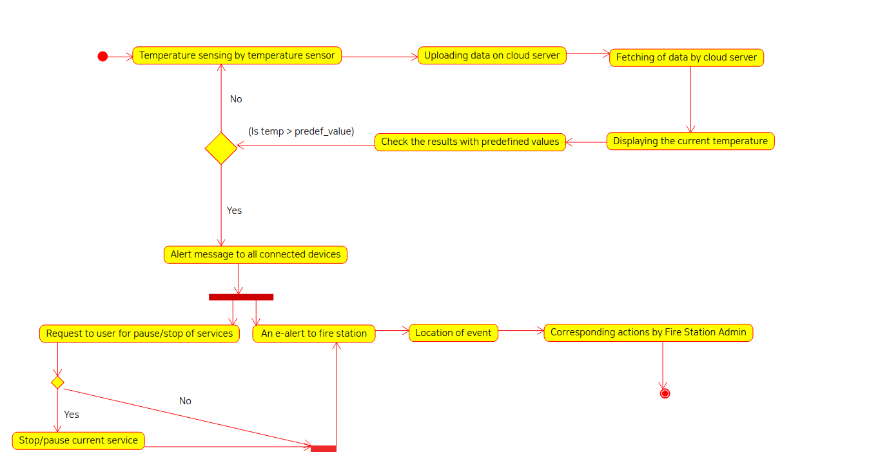
STATE DIAGRAM:

Slide 14
ADVANCEMENTS:
Sending building architecture of fire affected place to nearest fire station.
Checking severity of fire and quickly reporting to fire station admin to take proper steps.
Enabling live tracking feature of fire extinguisher van.
Uploading confidential and important data o cloud server within a short time span to avoid data loss.
Sending an alert to nearest hospital in case of medical emergency.

Slide 15
REFERANCES
Yen-Kuang Chen, Challenges and Opportunities of Internet of Things, in the proceedings of 17th Asia and South Pacific Design Automation Conference, , 30 Jan. 02 Feb., 2012, Santa Clara, CA, USA.
Miao Wu et. al., Research on the architecture of Internet of things, in the proceedings of 3rd International Conference on Advanced Computer Theory and Engineering, 20-22 August, 2012,Beijing, China.

Slide 16
QUESTIONS ?

Slide 17
THANK YOU…

